Slide 1
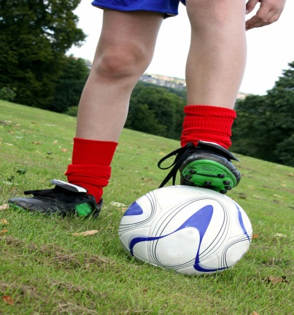
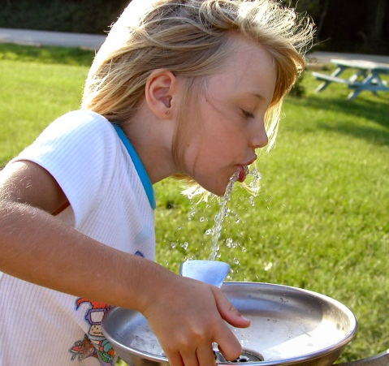
Healthy Eating - Healthy Lunchboxes
Busby Public School

Slide 2
Healthy Lunchboxes
Our school supports nutrition and physical activity initiatives.
Healthy eating and physical activity are encouraged for both health and educational benefits including
Growth and development
Development of good eating habits early
To prevent lifestyle disease
Concentration
Behaviour
We support and promote healthy behaviour and programs like:
Breakfast Club
Healthy Lunchboxes

Slide 3
Healthy Lunchboxes
As parents and carers you can help promote healthy lifestyle by:
Talking with your children about the importance of healthy eating and physical activity
Providing healthy food in lunchboxes
Being a great role model for your children

Slide 4
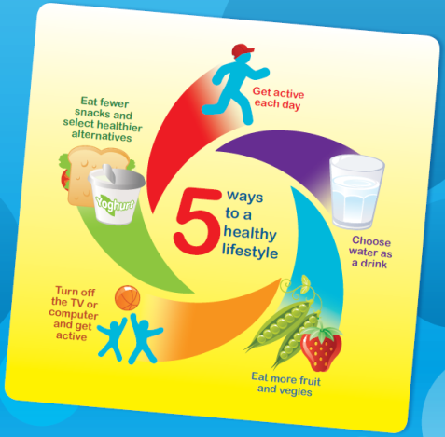
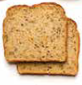
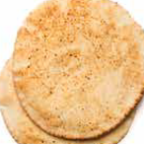
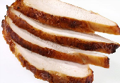
Healthy Lunchboxes
The base
Choose a grain based food to fill hungry tummies
The filling
Select a lean red or white meat filling or alternative
Vegetables and salad
Add two or more varieties for plenty of vitamins, minerals and dietary fibre
Water to drink and a piece of fruit
What to pack for lunch

Slide 5
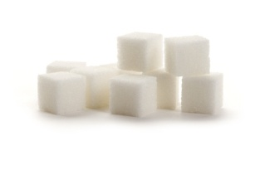
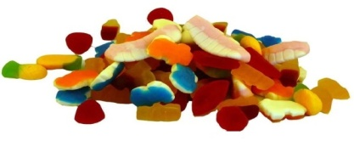
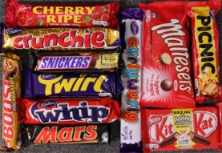
Healthy Lunchboxes
Avoid foods high in added sugar, salt and fat.
These are occasional and sometimes foods and best not packed for school.
Sweet biscuits are full of sugar eg cream biscuits, cookies
Muesli bars are great sometimes.
Corn chips
Donuts and cakes
Chocolates and lollies
Pies and sausage rolls
Sugar sweetened drinks (soft drinks, energy drinks, fruit drinks, cordial)
Poppers (can’t be resealed either)

Slide 6
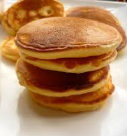
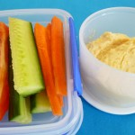
Healthy Lunchboxes
What to pack for recess
A boiled egg
Home-made low fat scones, muffins or pikelets
Salad vegetables
Vegetable sticks (carrot, cucumber and capsicum) with low fat dip
Fruit kebabs or fruit salad
Plain popcorn
Snack-sized tub of reduced fat yoghurt
Rice crackers or corn cakes with cubes or sliced reduced fat cheese

Slide 7
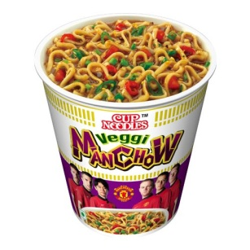
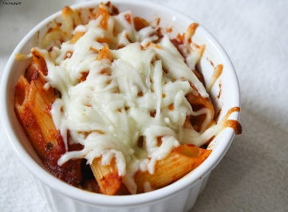
Healthy Lunchboxes
The school canteen sells many varieties of lunches and snacks. Please be mindful of:
Does your child like to eat that type of food?
Have they had it before?
Will they eat it all? (We have 10 minutes eating time)
Will the food be too messy to eat?
A suggestion is to have your child try the food at home first before you buy it for them at the school canteen.
It is recommended that lunch orders are an occasional treat.

Slide 8
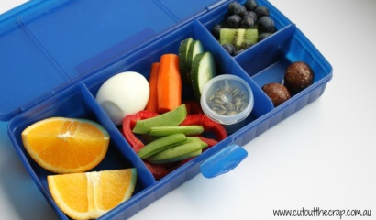
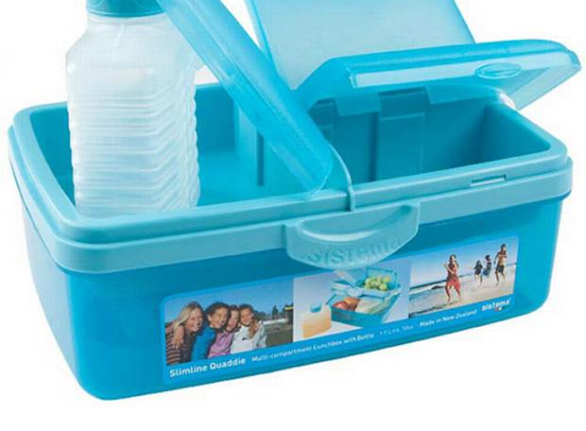
Healthy Lunchboxes
How to package your child’s food.
If you use cling wrap, make sure your child can open it. It can be quite sticky.
There are many lunchboxes on the market. Make sure your child can open the lunchbox you buy.
An ice brick is great to keep your child’s lunch cool.
If the lunchbox has lots of compartments, show your child where you are putting recess or fruit break etc.

Slide 9
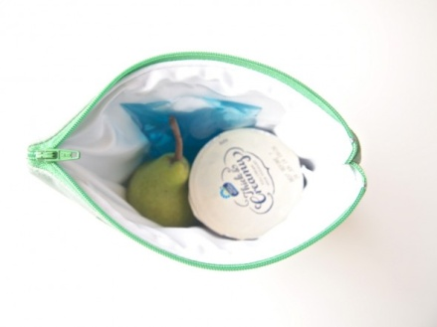
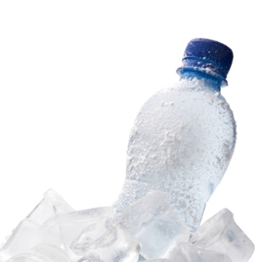
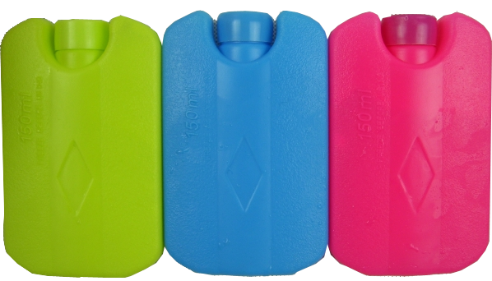
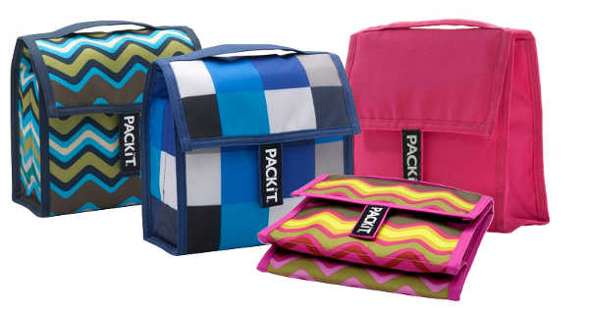
Healthy Lunchboxes
How to package your child’s food.
If you pack yoghurt or cheese, make sure they are kept cool especially in the warmer months.
An insulated lunchbox is great to keep these cool in with an ice brick too.
Water is best for your child to drink.
These can be frozen the night before. They keep lunches cool and your child has a lovely cold drink for lunch.

Slide 10
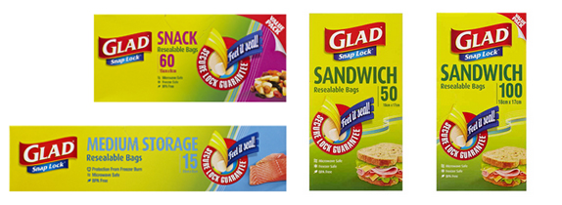
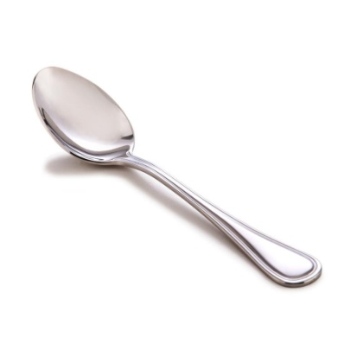
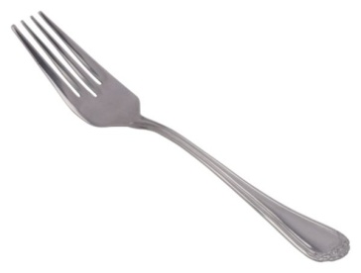
Healthy Lunchboxes
How to package your child’s food.
Don’t forget a spoon or fork if your child has noodles, rice, pasta or yoghurt.
Snap lock bags are great. They keep food fresh, they are easy to open and are disposable.
Remember to label all your child’s things.

Slide 11
Healthy Lunchboxes
Finally:
Don’t be surprised if your child does not eat everything you pack.
Please explain what food is lunch and what is for recess.
A practice run is great at home. Pack a lunchbox in the morning and through the day. Have your child get out morning tea, fruit break and lunch. This will give you an idea as to whether they can manage what you pack and how you pack. Check if they can open pre – packaged food. You can modify over the January holidays and by the time they come to school, your child will be an expert!!
The Early Stage 1 Team.

